Slide 1
SHAKE AT RESISTANT SUPPORTIVELY WITH SUPPORT LEVEL STAYING AROUND 1,640 POINTS
29/09/2025
REMARKABLE POINTS ON THE MARKET
Situation: the market dropped slightly when approaching resistant on recovering trend around 1,670 - 1,680 points. The liquidity was nearly flat and leaned on droppers. Red also appeared on VN30, HNX-Index.
Remarkable points of the session: red covered widely on Banking, Securities that still placed pressure on dropping trend, while the cash flow was positive on Real estate, Minerals.
Positive groups: Real estate VIC (+3.8%), HDG (+5.1%), KOS (+7.0%) l Basic Resources: BMC (+6.9%), TNI (+5.8%), HHP (+4.3%) l Insurance: BIC (+6.9%), BMI (+2.3%). Negative groups: Banking, Securities: TPB (-3.1%), HDB (-2.7%), VIX (-3.4%), SSI (-2.6%) l Food and beverage: PAN (-3.0%), DBC (-1.8%), ANV (-1.8%) l Utility: NT2 (-3.1%), REE (-1.9%), POW (-1.6%) l Oil: BSR (-1.6%), PVD (-1.5%), PVT (-3.7%) l Retail: MWG (-1.4%), DGW (-2.1%).
Impact: Gaining side | VIC, CTG, KDH, KBC - Dropping side | VPB, HDB, HVN, BID.
Foreign net selling was over 2 trillion, focusing on SSI, HPG, VIX, SHB, and net buying was on VCB, CII, HDG.
TECHNICAL POINT OF VIEW
% performance YTD of the indexes
VN-Index closed with hesitating Spinning top candle. The selling wasn’t too negative as the liquidity wasn’t too strong and correction still hasn’t denied previous gaining candle. Selling pressure appeared, suitable with the trade, as the index was still on correcting trend. the market might continue shaking to support the trend. Support level stayed around 1,640 points.
For HNX-Index, selling pressure also pushed the index to red, following previous session correction. The market was still supported within 272-278.
General strategy: New buying is suitable for surfing, having priority on upper level. Join in on the codes that confirmed the sign but shouldn’t use high margin at this phase, since general market still traded on correcting trend. For weak codes, lower the weight during recovery. Priority groups: Real estate, Public Investment (Infrastructure, Building materials), Retail, Utility.
STOCK RECOMMENDATION
Sell DHG – Buy PVT (Details in page 7) Derivatives (page 10)

Slide 2
MARKET STATISTICS
Market performance YTD
Source: FiinPro, PHS compiled

Slide 3
MARKET STATISTICS
Market performance of regional and key global equity markets
Global commodity prices performance
Source: Bloomberg, PHS compiled
Note: S&P 500, Dow Jones, FTSE 100 and Euro Stoxx 50 index reflect the previous trading session
Source: Bloomberg, PHS compiled
Note: (*) Price indices for the Chinese marke

Slide 4
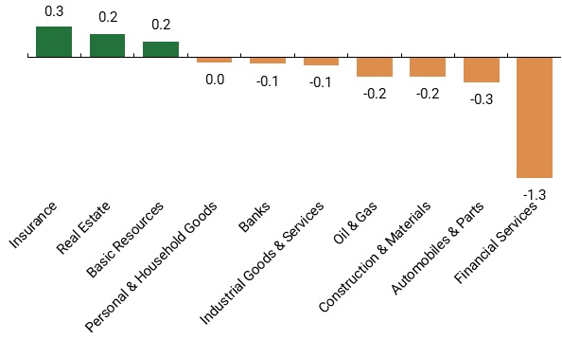
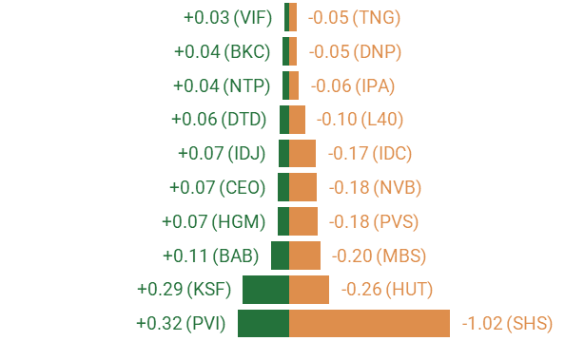
MARKET STATISTICS
TOP SECTORS IMPACTING VNINDEX
TOP TICKERS IMPACTING VNINDEX
TOP FOREIGN INVESTOR NET TRADE TICKERS VNINDEX
TOP SECTORS IMPACTING HNXINDEX
TOP TICKERS IMPACTING HNXINDEX
TOP FOREIGN INVESTOR NET TRADE TICKERS HNXINDEX

Slide 5
MARKET STATISTICS
TOP TRADING VALUE TICKERS (VND bn) - VNINDEX
TOP TICKERS IN AGREEMENT TRADE (VND bn) - VNINDEX
FOREIGN INVESTORS’ NET TRADING VALUE (VND bn) - VNINDEX
TOP TRADING VALUE TICKERS (VND bn) - HNXINDEX
TOP TICKERS IN AGREEMENT TRADE (VND bn) - HNXINDEX
FOREIGN INVESTORS’ NET TRADING VALUE (VND bn) - HNXINDEX

Slide 6
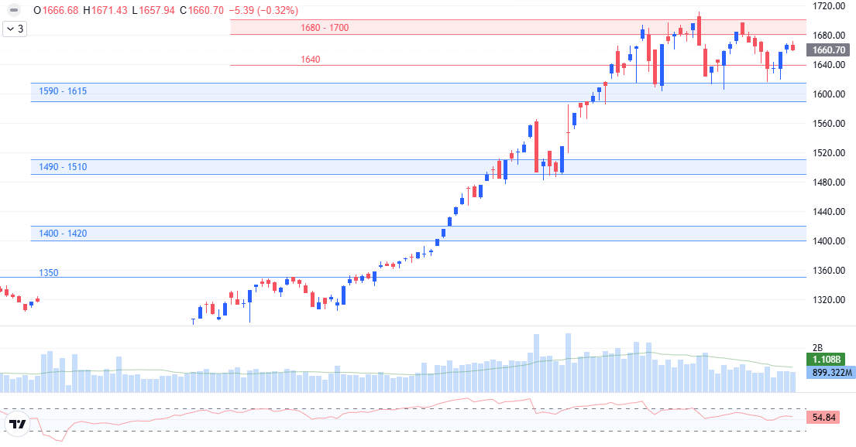
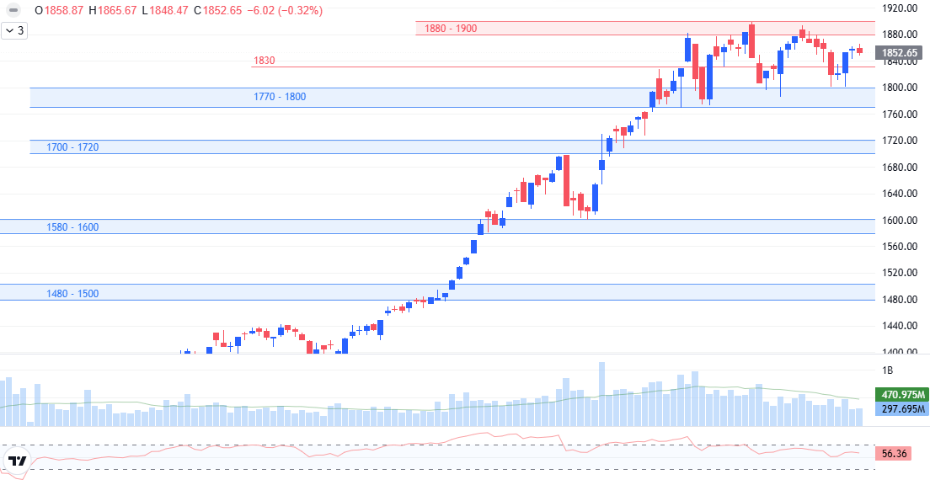
TECHNICAL ANALYSIS
VNINDEX TECHNICAL ANALYSIS
Spinning top candle, the volume dropped slightly.
Support: 1,590 – 1,615.
Resistant: 1,680 - 1,700.
MACD and RSI weakened.
Trend: correction.
Scenario: the selling took control here, however, correcting pressure is not too negative within small range and low volume. The index might shake further to support around 1,660 points. If it gains successfully to above 1,680, it might return to gaining trend. If it weakens at resistant, correcting pressure might take further control. Trend maintaining support is around 1,640 points.
VN30 TECHNICAL ANALYSIS
Spinning top candle, the volume is flat.
Support: 1,770 - 1,800.
Resistant: 1,880 - 1,900.
MACD and RSI weakened.
Trend: correction.
Red returned, showing selling at resistant. Large-cap groups took turn to control but the cash flow was not too negative, showing strong dropping matching volume. Instead, Mid-Small cap saw stronger trade. The trade might still support with motivation maintaining support beign around 1,830 points.

Slide 7
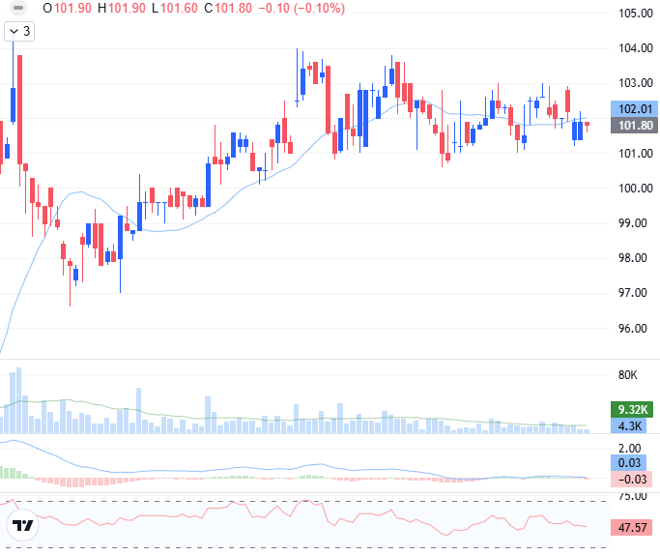
STOCK RECOMMENDATION
TECHNICAL ANALYSIS
Traded below day-MA20.
The liquidity showed cautious cash flow.
MACD cut down to signal while RSI also weakened to below 50, showing weak gaining motivation.
Risk of correcting further if losing support around 101.
Correcting trend might continue.
Recommend Sell around current level or using the shakes during the session, avoid strong correcting risk if losing support.

Slide 8
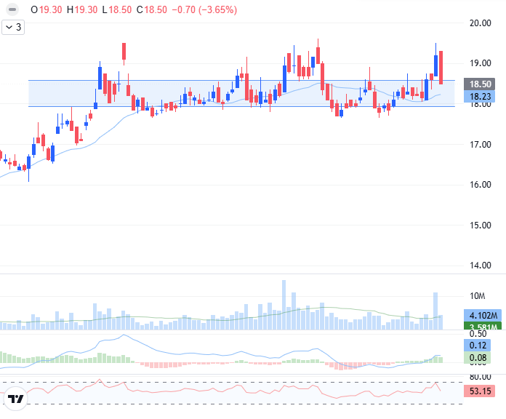
STOCK RECOMMENDATION
TECHNICAL ANALYSIS
Corrected to support level of 18 - 18.5.
The liquidity gained and agreed with the trend.
MACD cut up to signal line and was above positive level, while RSI also increased again to above average of 50, showing better gaining motivation.
MA10, 20, and 50 met and supported positively.
Sign of creating bottom and might return to gaining trend.
Recommend Buy around current level or using shakes during the session.

Slide 9
LIST OF RECOMMENDATIONS
Recommendations of the day
No. | Ticker | Recom- mend | Recommen-ded date | Current Price | Entry Price | Current profit/loss | Target price | Upside Potential | Cut loss price | Downside Risk | Note
1 | DHG | Sell | 29/09/2025 | 101.8 | 102.5 | -0.7% | 112.0 | 9.3% | 99 | -3.4% | Gaining trend weakened
2 | PVT | Buy | 29/09/2025 | 18.5 | 18.5 | 0.0% | 21.0 | 13.5% | 17.5 | -5.4% | Sign of creating bottom
List of recommendations
No. | Ticker | Recom- mend | Recommen-ded date | Recommen-ded date update | Current Price | Entry Price | Current profit/loss | Target price | Upside Potential | Cut loss price | Downside Risk | Note
1 | VNM | Buy | 04/09/2025 | - | 61.10 | 61.5 | -0.7% | 68.0 | 10.6% | 58.5 | -4.9%
2 | HPG | Buy | 12/09/2025 | - | 28.55 | 29.2 | -2.1% | 33.0 | 13.2% | 27.0 | -7.4%
3 | KSB | Buy | 15/09/2025 | - | 20.60 | 20.8 | -1.0% | 24.0 | 15.4% | 19.0 | -8.7%
4 | REE | Buy | 16/09/2025 | - | 66.30 | 68.0 | -2.5% | 76.0 | 11.8% | 64.0 | -5.9%
5 | CTD | Buy | 19/09/2025 | - | 82.00 | 81.8 | 0.2% | 92.0 | 12.5% | 76.0 | -7.1%
6 | HDC | Buy | 25/09/2025 | - | 37.05 | 36.9 | 0.5% | 42.0 | 14.0% | 34.0 | -7.7%
7 | YEG | Buy | 26/09/2025 | - | 15.00 | 14.7 | 2.4% | 16.5 | 12.6% | 13.6 | -7.2%

Slide 10
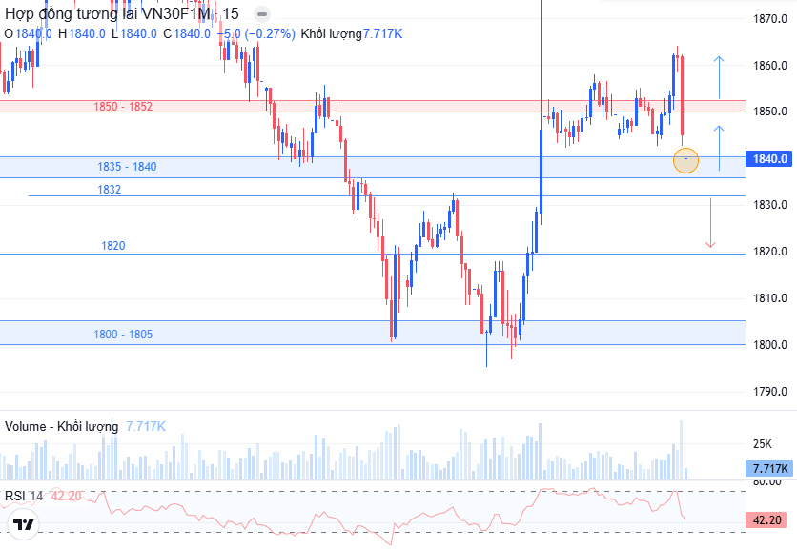
DERIVATIVES MARKET
Technical Analysis
VN30F1M closed at 1,840, down by nearly 9 points (-0.5%). The liquidity increased slightly with basis gap increased to 12.6 points. Foreign net selling was 171 contracts or over 30 billion. The trade recovered in most time but suddenly reversed near the end with selling taking strong control.
On 15-minute chart, the price dropped, creating Marubozu candle, completely denying gaining trend, showing correcting pressure taking control. MACD and RSI also weakened. However, 1,835 - 1,840 is strong support, need to follow the react.
Long positions can join when successfully testing support and staying above 1,838, ir if the trade breaks and supports above 1,852. Short positions can consider when the price weakens to below 1,835.
Daily strategy
Position | Trading point | Take profit | Cut loss | Reward/risk ratio
Long | > 1.838 | 1.850 | 1.833 | 12 : 5
Short | < 1.832 | 1.820 | 1.838 | 12 : 6
Long | > 1.852 | 1.864 | 1.846 | 12 : 6

Slide 11
DERIVATIVES MARKET
Open interest
Net trading contracts of foreign investors
Net trading contracts of institutions
Basis of future contracts
Yield curve of future contracts
VN30F1M – VN30F2M

Slide 12
EVENTS CALENDAR & DAILY NEWS
02/09 | Vietnam & America – PMI
05/09 | America – unemployment rate, non-agriculture salary rate Vietnam – FTSE releases portfolio
06/09 | Vietnam – releases Vietnam economic date in August and 8 months
10/09 | America – PPI
11/09 | America - CPI EU – ECB has press conference
12/09 | Vietnam – Vaneck releases portfolio
18/09 | America – FED releases administrative interest rate Vietnam – derivatives maturing
19/09 | Vietnam – Vaneck related ETF and FTSE restructured portfolio Japan – BOJ releases interest rate
25/09 | America – GDO final figure
26/09 | America – core PCE
30/09 | China – production PMI
MACRO INFORMATION
Vietnam is ready to work with America on resolving aqua product problem: Ministry of Foreign Affair spokesman Pham Thu Hang stated that Vietnam is ready to talk with America to deal with existed problems and push on fair and sustainable bilateral cooperation.
Real estate credit is growing fast: talking at Vietnam Finance Consulting Forum 2025 on September 25, Dr. Can Van Luc stated that real estate credit has increased by 20%, twice higher than the system credit growth, showing recovering sign on real estate. However, house price is increasing, above reach of the people.
CORPORATION NEWS
IJC – IJC leader: offer 251 million shares to prepare for the opportunity from merging and section connection: IJC offers to sell 251 million shares at 10,000 dong/share to speed ip on real estate and infrastructure. Profit focused in second half of the year, mainly from Sunflower II and Hoa Loi. Merging Binh Duong in HCMC opens opportunity for land and house price increasing, along with the plan of expanding to Binh Phuoc to prepare for FDI.
VCG – Vinaconex invests 4.5 trillion in the capital most modern medical complex: following Ministry of Politics Resolution number 72, Vinaconex started AEGIS medical complex in Hanoi with total investment of 4.5 trillion. The project floor area is 287,000 m2, including 26 floors, 4 basement floors, and 8-floor multifunction blocks, with 1,000 beds, applying smart hospital model under JCI international standard.
ITC – Vinaconex-ITC sued leader group, creating a new step for Cat Ba Amatina project: Vinaconex-ITC sued 2025-2030 term BoM and Supervisory Board, accepting new shareholder group with 92.2% capital, expecting to stabilize the organization, strengthening finance, and pushing on Cat Ba Amatina project of 170ha with investment of nearly 11 trillion.
KDC – Kido Group leader wants to sell 400,000 KDC shares: Mr. Tran Quoc Nguyen, Kido BoM member, registering to sell 438,171 shares to resolve personal finance problem, expecting from September 30 to October 29, 2025. First half 2025, Kido revenue is 4,156.8 billion (+18%), net profit is 57.4 billion, up by 80.5% YoY.
HUT – Mr. Vu Dinh Do’s company spent 6 trillion to buy over 300 million Tasco shares: On September 23, 2025, VII Holding with Vu Dinh Do as President bought 302.5 million Tasco shares, accounting 28.32% capital, at over 6 trillion, becoming biggest institute shareholder. The trade is approved by 2024 shareholder board. In first half of 2025, Tasco revenue is 15,351 billion, up by 31% and profit is over 114 billion, up by 25%.

Slide 13
LISTS OF ANALYZED STOCKS

Slide 14
DISCLAIMER
Analyst Certification
The report was prepared by Le Tran Khang, Senior Analyst – Phu Hung Securities Corporation. Each research analyst(s), strategist(s) or research associate(s) responsible for the preparation and content of all or any identified portion of this research report hereby certifies that, with respect to each issuer or security or any identified portion of the report with respect to each issuer or security that the research analyst, strategist or research associate covers in this research report, all of the views expressed by that research analyst, strategist or research associate in this research report accurately reflect their personal views about those issuer(s) or securities. Each research analyst(s), strategist(s) or research associate(s) also certify that no part of their compensation was, is, or will be, directly or indirectly, related to the specific recommendation(s) or view(s) expressed by that research analyst, strategist or research associate in this research report
Rating definition
BUY: The code has gaining potential of over 20% RAISE WEIGHT: The code has gaining potential of 10% - 20%
HOLD: The code has limited growing potential of less than 10% LOWER WEIGHT: The code might drop slightly by 0% - 10%
SELL: The code might drop by over 10% NON RATED: The code is not rated within PHS’s observation range or not yet listed
Efficiency is total profit of 12 months (including dividend)
Disclaimer
This research report has been prepared by Phu Hung Securities Corporation (PHS) for informational purposes only. The information contained herein has been obtained from sources believed to be reliable, but PHS does not guarantee its accuracy or completeness. Opinions, estimates, and projections in this report constitute the current judgment of the author as of the date of this report and are subject to change without notice. This report is not an offer to sell or a solicitation of an offer to buy any securities. It is not intended to provide personal investment advice and it does not take into account the specific investment objectives, financial situation, or needs of any particular person. PHS, its affiliates, and/or their respective officers, directors, or employees may have interests or positions in, and may effect transactions in, the securities or options referred to herein. PHS may also perform or seek to perform investment banking or other services for the companies mentioned in this report. Neither PHS nor any of its affiliates, nor any of PHS’s respective officers, directors, or employees, accepts any liability whatsoever for any direct or consequential loss arising from any use of this report or its contents
© Phu Hung Securities Corporation
21st Floor, Phu My Hung Tower, 8 Hoang Van Thai Street, Tan My Ward, HCMC
Phone: (+84-28) 5 413 5479 Fax: (+84-28) 5 413 5472
Customer Service: 1900 25 23 58 Call-center: (+84-28) 5 413 5488
E-mail: info@phs.vn / support@phs.vn Web: www.phs.vn
District 1 Branch Room 1003A, 10th Floor, No. 81-83-83B-85 Ham Nghi Street, Sai Gon Ward, Ho Chi Minh City Phone: (+84-28) 3 535 6060 Fax: (+84-28) 3 535 2912 | District 3 Branch 4th Floor, 458 Nguyen Thi Minh Khai, Ban Co Ward, Ho Chi Minh City Phone: (+84-28) 3 820 8068 Fax: (+84-28) 3 820 8206 | Tan Binh Branch Park Legend Building, 251 Hoang Van Thu Street, Tan Son Hoa Ward, Ho Chi Minh City Phone: (+84-28) 3 813 2401 Fax: (+84-28) 3 813 2415
Thanh Xuan Branch 5th Floor, UDIC Complex Building, N04 Hoang Dao Thuy, Thanh Xuan Ward, Ha Noi Phone: (+84-24) 6 250 9999 Fax: (+84-24) 6 250 6666 | Hai Phong Branch 2nd Floor, Building No.18 Tran Hung Dao, Hoang Van Thu Ward, Hong Bang Ward, Hai Phong Phone: (+84-22) 384 1810 Fax: (+84-22) 384 1801

