Slide 1
Banking returned to lead, foreign saw another net buying session
04/12/2025
REMARKABLE POINTS ON THE MARKET
Situation: VN-Index closed at 1,731.8, up by 14.7 points (+0.86%). The liquidity increaased and leaned on buyers. Green also appeared on VN30, HNX-Index.
Remarkable points of the session: Banking pillars returned to support the index. The trade was more consistent with green in control. Besides, foreign investors saw another net buying session which was positive.
Positive groups: Banking: CTG (+6.0%), VPB (+4.7%), MBB (+4.3%) l Retail: FRT (+7.0%), MWG (+5.9%) l Food and beverage: BAF (+3.4%), MSN (+2.5%) l Industrial goods and services: VSC (+2.9%), VTP (+1.0%) l Finance services: CTS (+2.8%), VCI (+1.9%). Negative groups: Real estate: VIC (-2.0%), VRE (-1.1%), KOS (-0.4%) l Utility: GAS (-2.4%), POW (-0.3%) l Tourism and entertainment: VPL (-3.7%), VJC (-1.8%)
Impact: Gaining side | CTG, BID, VCB, VPB, MBB - Dropping side | VIC, VPL, GAS, VJC, GEE
Foreign net buying was nearly 3.7 trillion, focusing on VPL (over 300 billion), MBB, VPB, and net selling was on VIC, VCB, FPT.
TECHNICAL POINT OF VIEW
% performance YTD of the indexes
VN-Index lowered the gain at the end and closed with hesitating Spinning top candle, showing stronger selling when approaching resistant of 1,750. RSI is also moving to overbuying level and might make gaining motivation slowing down. The trade might shake and support around 1,700 points. If collection is positive, target resistant might be 1,750 and further on 1,800 points. Trend maintaining support is around 1,680. If the index weakens below this level, it might move to 1,640 - 1,680 and return to moving flat.
For HNX-Index, the index also closed in hesitation and the liquidity wasn’t remarkable, showing cautious buying. The trade tended to be flat to test support level of 256 - 262.
General strategy: observe the sign of support above 1,700. If the liquidity and the trade improve further, it will be foundation for disbursing. Some standing out groups with positive test are Banking, Consumption, Oil, Utility.
STOCK RECOMMENDATION
Buy DBC (Details in page 7) Derivatives (page 9)

Slide 2
MARKET STATISTICS
Market performance YTD
Source: FiinPro, PHS compiled

Slide 3
MARKET STATISTICS
Market performance of regional and key global equity markets
Global commodity prices performance
Source: Bloomberg, PHS compiled
Note: S&P 500, Dow Jones, FTSE 100 and Euro Stoxx 50 index reflect the previous trading session
Source: Bloomberg, PHS compiled
Note: (*) Price indices for the Chinese marke

Slide 4
MARKET STATISTICS
TOP SECTORS IMPACTING VNINDEX
TOP TICKERS IMPACTING VNINDEX
TOP FOREIGN INVESTOR NET TRADE TICKERS VNINDEX
TOP SECTORS IMPACTING HNXINDEX
TOP TICKERS IMPACTING HNXINDEX
TOP FOREIGN INVESTOR NET TRADE TICKERS HNXINDEX

Slide 5
MARKET STATISTICS
TOP TRADING VALUE TICKERS (VND bn) - VNINDEX
TOP TICKERS IN AGREEMENT TRADE (VND bn) - VNINDEX
FOREIGN INVESTORS’ NET TRADING VALUE (VND bn) - VNINDEX
TOP TRADING VALUE TICKERS (VND bn) - HNXINDEX
TOP TICKERS IN AGREEMENT TRADE (VND bn) - HNXINDEX
FOREIGN INVESTORS’ NET TRADING VALUE (VND bn) - HNXINDEX

Slide 6
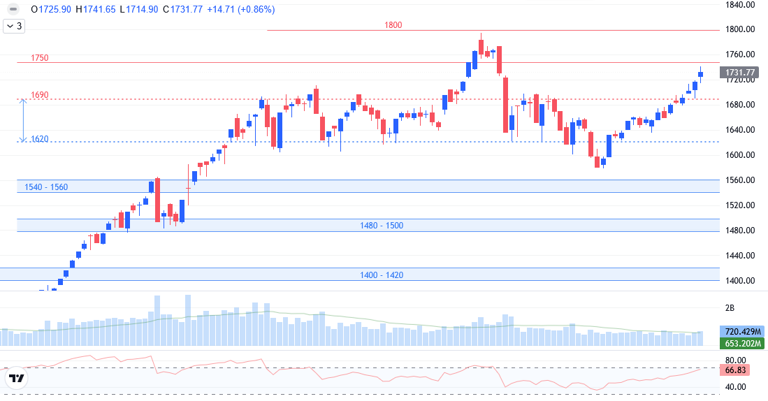
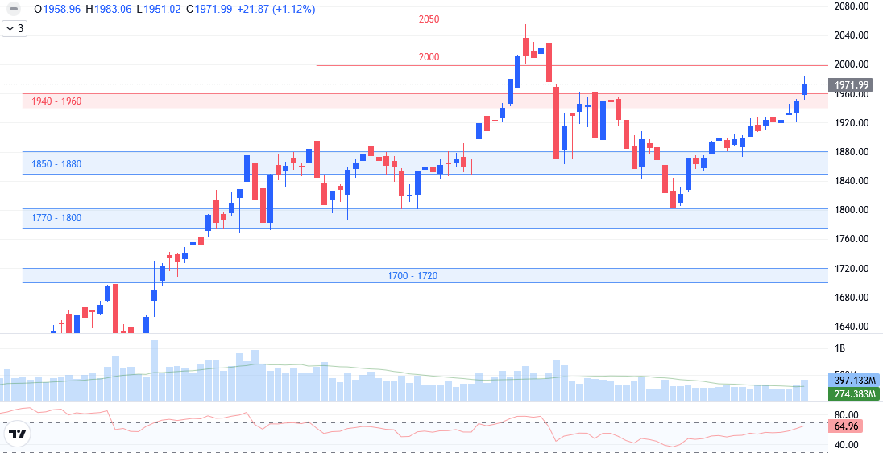
TECHNICAL ANALYSIS
VNINDEX TECHNICAL ANALYSIS
Spinning top candle, the volume stayed above 20-session average.
Support: 1,680 - 1,700.
Resistant: 1,750
RSI nearly approached overbuying level.
Trend: technical recovery.
Scenario: VN-Index closed with hesitating Spinning top candle, showing stronger selling when approaching resistant of 1,750. RSI is also movign to overbuying of 70 and might make gaining motivation slowing down. The trade might shake and support further above 1,700 to collect before breaking. Trend maintaining support level is around 1,680.
VN30 TECHNICAL ANALYSIS
Spinning top candle, the volume stayed above 20-session average.
Support: 1,900 - 1,920.
Resistant: 2,000.
RSI nearly approached overbuying level.
Trend: technical recovery.
Banking returned to lead VN30, and the liquidity increased strongly, agreeing with the trend. However, the index couldn’t close at day-highest level, showing the selling in control. Moreover, RSI also approached overbuying level. The trade might need further support at 1,940 - 1,960. Trend maintaining support level is raised to around 1,900.

Slide 7
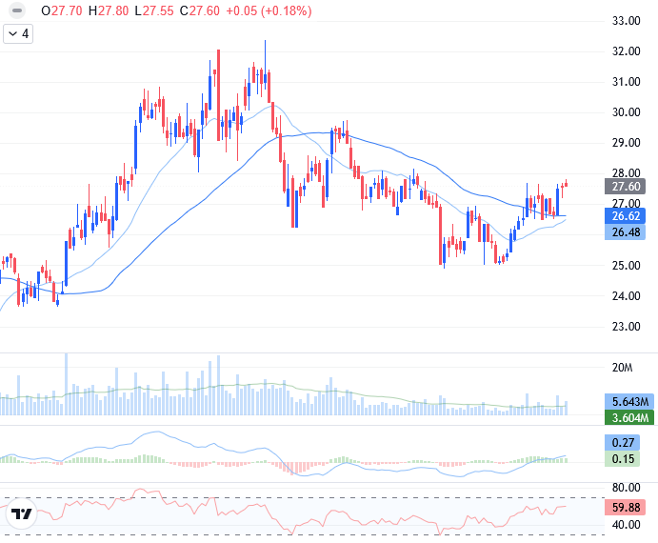
STOCK RECOMMENDATION
TECHNICAL ANALYSIS
Escaped collecting level of 27.
The liquidity improved, showing the cash flow returning.
MACD cut up to signal line and return to positive level, and RSI also improved to above average of 50, showing gaining motivation recovering.
MA20 cut up to MA50, will support mid-term trend.
Correcting trend is healthy and expect to return to gaining trend.
Recommend Buy around current level or use shake during the session.

Slide 8
LIST OF RECOMMENDATIONS
Recommendations of the day
No. | Ticker | Recom- mend | Recommen-ded date | Current Price | Entry Price | Current profit/loss | Target price | Upside Potential | Cut loss price | Downside Risk | Note
1 | DBC | Buy | 04/12/2025 | 27.6 | 27.6 | 0.0% | 30.5 | 10.5% | 26 | -5.8% | Test support positively
List of recommendations
No. | Ticker | Recom- mend | Recommen-ded date | Recommen-ded date update | Current Price | Entry Price | Current profit/loss | Target price | Upside Potential | Cut loss price | Downside Risk | Note
1 | PC1 | Hold | 18/11/2025 | 02/12/2025 | 23.25 | 22.5 | 3.3% | 25.0 | 11.1% | 21.0 | -6.7%
2 | KDH | Buy | 27/11/2025 | - | 34.20 | 35.4 | -3.4% | 39.0 | 10.2% | 33.0 | -6.8%
3 | PHR | Buy | 28/11/2025 | - | 58.00 | 56.60 | 2.5% | 64.0 | 13.1% | 53.0 | -6.4%
4 | DGW | Buy | 01/12/2025 | - | 44.70 | 43.7 | 2.3% | 50.0 | 14.4% | 40.0 | -8.5%
5 | NTP | Buy | 03/12/2025 | - | 64.50 | 64.20 | 0.5% | 71.0 | 10.6% | 61.0 | -5.0%

Slide 9
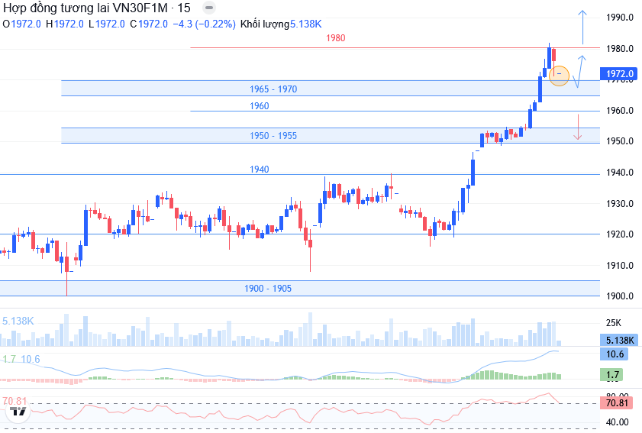
DERIVATIVES MARKET
Technical Analysis
VN30F1M closed at 1,972, up by 25 points (+1.3%). Opened with up-gap and stayed on uptrend. The trade was stronger in afternoon with Long side taking complete control.
On 15-minute chart, MACD dropped and RSI reversed to high overbuying level, showing correcting pressure. The trade broke quickly so it is suitable to adjust collectively. Test level is around 1,965 - 1,970. Long side can wait till dropping to support, or when breaking and staying above 1,980. Short side is limited, consider when dropping to below 1,958.
VN100F1M closed at 1,867.1, up by 22.2 points (+1.2%). Basis gap is 1.5 points (below basic VN100). Matched volume dropped to 21 contracts. Close support is around 1,855 - 1,860, while resistant is 1,880.
Daily strategy
Position | Trading point | Take profit | Cut loss | Reward/risk ratio
Long | > 1.968 | 1.980 | 1.960 | 12 : 08
Long | > 1.980 | 1.995 | 1.970 | 15 : 10
Short | < 1.958 | 1.948 | 1.965 | 10 : 07

Slide 10
VN30 INDEX FUTURES 1 MONTH CONTRACT
Open interest
Net trading contracts of foreign investors
Net trading contracts of institutions
Basis of future contracts
Yield curve of future contracts
VN30F1M – VN30F2M

Slide 11
EVENTS CALENDAR & DAILY NEWS
01/12 | Vietnam & US – PMI Index
05/12 | Vietnam– FTSE announces portfolio review US – Unemployment Rate
06/12 | Vietnam – Release of Economic Data for November and the First Eleven Months
09/12 | Australia – RBA Rate Statement
10/12 | US –Consumer Price Index (CPI) Canada – BOC Rate Statement
11/12 | US - Federal Funds Rate, Producer Price Index (PPI)
12/12 | Vietnam – Vaneck announces portfolio review
17/12 | US – Retail Sales
18/12 | Vietnam – Derivatives Expiration UK – Official Bank Rate (BoE)
19/12 | Vietnam – Vaneck & FTSE ETF rebalancing trades Japan –BOJ Policy Rate US – Final GDP Release
31/12 | US – FOMC Meeting Minutes
MACRO INFORMATION
Interbank interest rate increased to 7%: overnight interest rate increased to above 7%/year on December 01, the highest of 3 years, showing sign on liquidity pressure at the end of the year. Therefore, SBV pushed on the system support by OMO market.
Complete resolving problems for 1,759 land projects: the Government, Prime Minister focus on instructing related ministries, authorities and provinces quickly complete resolving the problems for the projects for positive results. In detail, completing resolving 1,759 over 2,161 land projects, reaching 81.39%. The report on December 3 morning session of Parliament 10th meeting.
CORPORATION NEWS
FMC - Sao Ta revenue dropped strongly in November 2025: In November, Sao Ta saw positive growth, as shrimp production is 1,984 tons, up by 32% YoY, and agriculture is 52 tons, up by 23%. However, the selling slowed down with shrimp of 1,490 tons, down by 9%, and agriculture of only 29 tons, down strongly by 69% YoY. Accordingly, combined revenue in November is 16.16 million USD, down by 12% YoY and nearly 39% MoM.
LPB - LPBank submitted to raise foreign room to 30%: the bank released information on 2025 irregular general meeting, expecting to take place in Ninh Binh. One of the contents submitting to shareholders is adjusting foreign room from 5% to 30%. According to LPBank, raising foreign room is within the target of integrating to attract high quality resource to support the bank development strategy in middle and long term.
POW - PV Power issues nearly 726 million shares: PV Power issues over 726 million shares, including private offer at 10,000 dong/share and bonus shares, paying dividend at the rate of over 19%. All collection of over 2,810 billion will be used on Nhon Trach 3 and 4 Power Plant project. In 9 months 2025, revenue is 25,404 billion (96% target), EAT is 2,182 billion, surpassing 497% year-target.
PTB will soon offer over 13 million shares: December 15, Phu Tai will close shareholder list to carry out the rights of buying shares. PTB will offer nearly 13.4 million shares to existed shareholders at the rate of 5:1, shareholders can buy 1 new share for every 5 shares on hand, at selling price of 12,000 dong/share. Total collection from is expected at nearly 161 billion, will be added to subsidiary companies, including Phuc Tan Kieu one member ltd. with 44.5 billion, and Phu Tai Binh Dinh Wood one member ltd. with 116 billion.
VCI - apply more loans, Vietcap expects to mobilize maximum of 3 trillion dong by bonds: On December 01, BoM of Vietcap securities approved to publicly issue bonds, total offer in par value is maximum of 3 trillion, dividing into 3 phases. The bonds are non-convertible, with no stock right attached, and no guaranteed asset. On the same day, BoM also decided to approve selling registry and operation.

Slide 12
LISTS OF ANALYZED STOCKS

Slide 13
DISCLAIMER
Analyst Certification
The report was prepared by Le Tran Khang, Senior Analyst – Phu Hung Securities Corporation. Each research analyst(s), strategist(s) or research associate(s) responsible for the preparation and content of all or any identified portion of this research report hereby certifies that, with respect to each issuer or security or any identified portion of the report with respect to each issuer or security that the research analyst, strategist or research associate covers in this research report, all of the views expressed by that research analyst, strategist or research associate in this research report accurately reflect their personal views about those issuer(s) or securities. Each research analyst(s), strategist(s) or research associate(s) also certify that no part of their compensation was, is, or will be, directly or indirectly, related to the specific recommendation(s) or view(s) expressed by that research analyst, strategist or research associate in this research report
Rating definition
BUY: The code has gaining potential of over 20% RAISE WEIGHT: The code has gaining potential of 10% - 20%
HOLD: The code has limited growing potential of less than 10% LOWER WEIGHT: The code might drop slightly by 0% - 10%
SELL: The code might drop by over 10% NON RATED: The code is not rated within PHS’s observation range or not yet listed
Efficiency is total profit of 12 months (including dividend)
Disclaimer
This research report has been prepared by Phu Hung Securities Corporation (PHS) for informational purposes only. The information contained herein has been obtained from sources believed to be reliable, but PHS does not guarantee its accuracy or completeness. Opinions, estimates, and projections in this report constitute the current judgment of the author as of the date of this report and are subject to change without notice. This report is not an offer to sell or a solicitation of an offer to buy any securities. It is not intended to provide personal investment advice and it does not take into account the specific investment objectives, financial situation, or needs of any particular person. PHS, its affiliates, and/or their respective officers, directors, or employees may have interests or positions in, and may effect transactions in, the securities or options referred to herein. PHS may also perform or seek to perform investment banking or other services for the companies mentioned in this report. Neither PHS nor any of its affiliates, nor any of PHS’s respective officers, directors, or employees, accepts any liability whatsoever for any direct or consequential loss arising from any use of this report or its contents
© Phu Hung Securities Corporation
21st Floor, Phu My Hung Tower, 8 Hoang Van Thai Street, Tan My Ward, HCMC
Phone: (+84-28) 5 413 5479 Fax: (+84-28) 5 413 5472
Customer Service: 1900 25 23 58 Call-center: (+84-28) 5 413 5488
E-mail: info@phs.vn / support@phs.vn Web: www.phs.vn
District 1 Branch Room 1003A, 10th Floor, No. 81-83-83B-85 Ham Nghi Street, Sai Gon Ward, Ho Chi Minh City Phone: (+84-28) 3 535 6060 Fax: (+84-28) 3 535 2912 | District 3 Branch 4th Floor, 458 Nguyen Thi Minh Khai, Ban Co Ward, Ho Chi Minh City Phone: (+84-28) 3 820 8068 Fax: (+84-28) 3 820 8206 | Tan Binh Branch Park Legend Building, 251 Hoang Van Thu Street, Tan Son Hoa Ward, Ho Chi Minh City Phone: (+84-28) 3 813 2401 Fax: (+84-28) 3 813 2415
Thanh Xuan Branch 5th Floor, UDIC Complex Building, N04 Hoang Dao Thuy, Thanh Xuan Ward, Ha Noi Phone: (+84-24) 6 250 9999 Fax: (+84-24) 6 250 6666 | Hai Phong Branch 2nd Floor, Building No.18 Tran Hung Dao, Hoang Van Thu Ward, Hong Bang Ward, Hai Phong Phone: (+84-22) 384 1810 Fax: (+84-22) 384 1801

