Slide 1
ENDED 2025, THE MARKET STILL HASN’T FOUND COMMON VOICE
05/01/2026
REMARKABLE POINTS ON THE MARKET
Situation: VN-Index closed at 1,784.5, up by 17.6 points (+1.00%). The liquidity increased but stayed below 20-session average. VN30 gained while HNX-Index dropped.
Remarkable points of the session: Vingroup still led the index’s gain. However, the market still leaned on droppers.
Positive groups: Real estate: VHM (+5.5%), VIC (+4.1%), KBC (+2.8%) l Banking: HDB (+6.3%), TCB (+1.6%) l Tourism and entertainment: VPL (+3.5%), VJC (+1.8%). Negative groups: Construction and materials: CII (-4.6%), DLG (-2.6%), DHA (-2.1%) l Food and beverage: ANV (-2.8%), DBC (-1.5%) l Industrial goods and services: TV2 (-2.3%), PVT (-2.1%) l Utility: GAS (-3.3%), POW (-0.8%) l Finance services: FTS (-1.9%), VIX (-1.8%).
Impact: Gaining side | VIC, VHM, HDB, VPL, TCB – Dropping side | GAS, STB, BID, BVH, GVR
Foreign net buying was over 700 billion, focusing on STB, VPL, MWG, and net selling was on HDB, LPB, VPX.
TECHNICAL POINT OF VIEW
VN-Index closed final session of 2025 with green candle, maintaining gaining chain of 4 sessions. However, the gain relied mainly on pillars, with Vingroup leading. The market hasn’t improved much and gaining consistency was still weak, and droppers still took control. Besides, the liquidity was also low below 20-session average. This will cause trouble for the gain if VN-Index approaches sentimental resistant of 1,800, liquidity and trend still weakened. Correcting pressure might return to take control. Close support for current trend is around 1,720 while resistant is 1,850 – 1,860 if breaking successfully.
For HNX-Index, the supply still took control so the index closed in red. The trade still struggled and supported around 248 – 250, equivalent to recent bottom level.
General strategy: the trade tended to Hold with average weight. Consider lowering if the trend is broken (breaking mid-term support). Shouldn’t rush to new buying, observe the market’s consistent sign. The index gained and the cash flow spread with the liquidity confirming to join and raise weight. Standing out groups: Banking, Utility, Consumption, Oil.
% performance YTD of the indexes
STOCK RECOMMENDATION
Take profit PHR, Cut loss TV2 (Details in page 7) Derivatives (page 10)

Slide 2
MARKET STATISTICS
Market performance YTD
Source: FiinPro, PHS compiled

Slide 3
MARKET STATISTICS
Market performance of regional and key global equity markets
Global commodity prices performance
Source: Bloomberg, PHS compiled
Note: S&P 500, Dow Jones, FTSE 100 and Euro Stoxx 50 index reflect the previous trading session
Source: Bloomberg, PHS compiled
Note: (*) Price indices for the Chinese marke

Slide 4
MARKET STATISTICS
TOP SECTORS IMPACTING VNINDEX
TOP TICKERS IMPACTING VNINDEX
TOP FOREIGN INVESTOR NET TRADE TICKERS VNINDEX
TOP SECTORS IMPACTING HNXINDEX
TOP TICKERS IMPACTING HNXINDEX
TOP FOREIGN INVESTOR NET TRADE TICKERS HNXINDEX

Slide 5
MARKET STATISTICS
TOP TRADING VALUE TICKERS (VND bn) - VNINDEX
TOP TICKERS IN AGREEMENT TRADE (VND bn) - VNINDEX
FOREIGN INVESTORS’ NET TRADING VALUE (VND bn) - VNINDEX
TOP TRADING VALUE TICKERS (VND bn) - HNXINDEX
TOP TICKERS IN AGREEMENT TRADE (VND bn) - HNXINDEX
FOREIGN INVESTORS’ NET TRADING VALUE (VND bn) - HNXINDEX

Slide 6
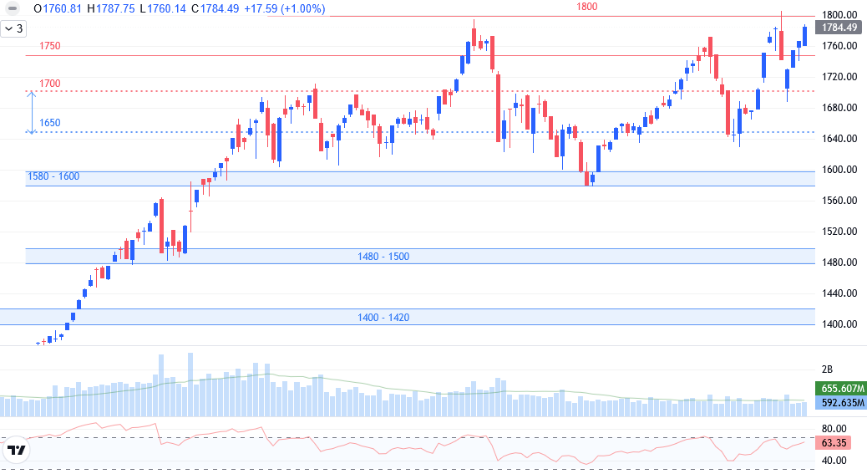
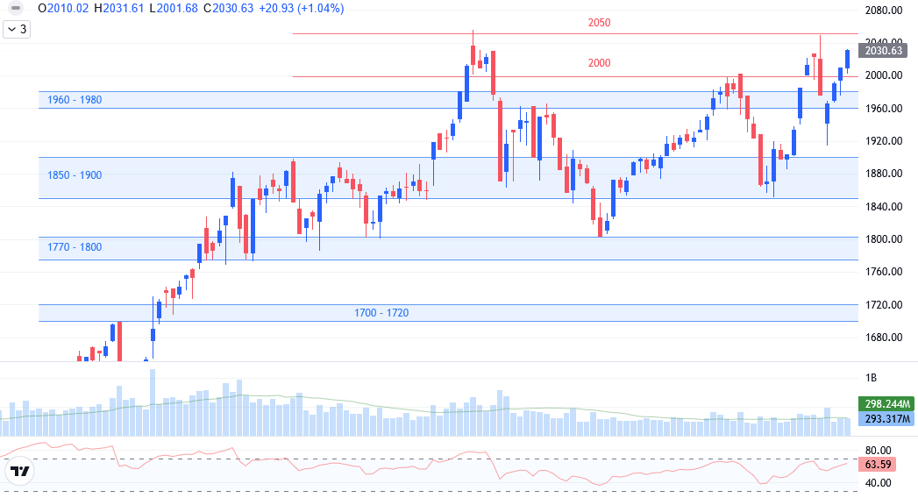
TECHNICAL ANALYSIS
VNINDEX TECHNICAL ANALYSIS
Big green candle but the volume stayed below 20-session average.
Support: 1,700 – 1,720.
Resistant: 1,800.
RSI and MACD hasn’t improved clearly.
Trend: test old peak level.
Scenario: gaining trend was still maintained with main motivation from large-cap. However, the liquidity was still low and the market hasn’t improved much. With hesitating demand, VN-Index might see trouble when approaching 1,800. The trade might slow down or shake collectively further around 1,750 – 1,780 before breaking.
VN30 TECHNICAL ANALYSIS
Big green candle but the volume stayed below 20-session average.
Support: 1,960 – 1,980.
Resistant: 2,040 – 2,050.
RSI and MACD hasn’t improved clearly.
Trend: test old peak level.
The index still traded above 2,000. The liquidity increased stronger than VN-Index, showing that the cash flow styed on large-cap. However, matched volume only improved but hasn’t confirmed convincing break. The trade might struggle again and support the price. Short-term support is raised to around 1,980.

Slide 7
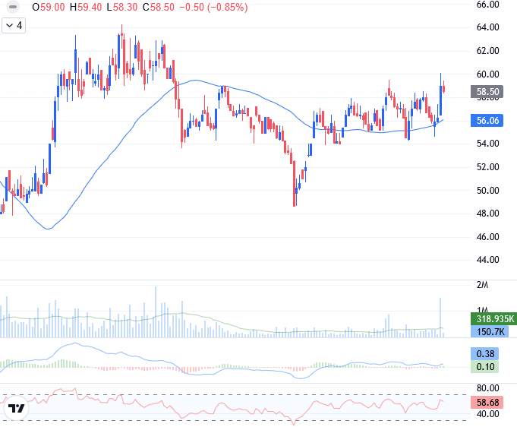
STOCK RECOMMENDATION
TECHNICAL ANALYSIS
Corrected when approaching resistant around 60.
The liquidity was remarkable in the gain but couldn’t close above resistant, and the trade also weakened in following session.
Market risk: VN-Index approached peak level but lack of spreading, the gain focused on pillars and there will be correcting risk of this group loses its trend.
The trend might slow down to support the trend.
Recommend Take profit around current level or use shakes in the session.

Slide 8
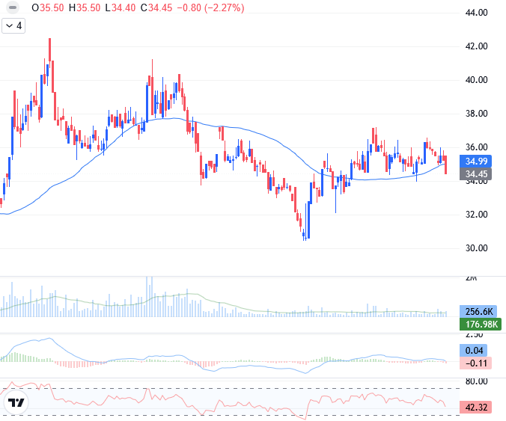
STOCK RECOMMENDATION
TECHNICAL ANALYSIS
Corrected below day-MA50.
The liquidity increased, showing the selling taking control.
MACD cut down to signal line, and RSI dropped to below average, showing gaining motivation weakening.
Market risk: VN-Index approached peak level but lack of spreading, the gain focused on pillars and there will be correcting risk of this group loses its trend.
Gaining trend is broken.
Recommend sell around current level or use recoveries of the session.

Slide 9
LIST OF RECOMMENDATIONS
Recommendations of the day
No. | Ticker | Recom- mend | Recommen-ded date | Current Price | Entry Price | Realized profit/loss | Target price | Upside Potential | Cut loss price | Downside Risk | Note
1 | PHR | Take profit | 05/01/2026 | 58.50 | 58.5 – 59.5 | 4.7% | 64.0 | 13.1% | 54 | -4.6%
2 | TV2 | Cut loss | 05/01/2026 | 34.5 | 34.5 – 35 | -4.0% | 40.0 | 10.2% | 34 | -6.3%
List of recommendations
No. | Ticker | Recom- mend | Recommen-ded date | Recommen-ded date update | Current Price | Entry Price | Current profit/loss | Target price | Upside Potential | Cut loss price | Downside Risk | Note
1 | NTP | Hold | 03/12/2025 | 11/12/2025 | 65.90 | 64.2 | 2.6% | 71.0 | 10.6% | 61.5 | -4.2%
2 | DBC | Hold | 04/12/2025 | 24/12/2025 | 27.05 | 27.6 | -2.0% | 30.5 | 10.5% | 26.5 | -4.0% | Raise stop loss to 26.5
3 | POW | Buy | 19/12/2025 | - | 12.70 | 12.30 | 3.3% | 14.0 | 13.8% | 11.4 | -7.3%
4 | KLB | Buy | 23/12/2025 | - | 16.80 | 17.2 | -2.3% | 20.0 | 16.3% | 15.8 | -8.1%
5 | VNM | Buy | 25/12/2025 | - | 61.20 | 61.50 | -0.5% | 68.0 | 10.6% | 58.0 | -5.7%
6 | PLX | Buy | 29/12/2025 | - | 35.3 | 35.6 | -0.7% | 39.0 | 9.7% | 34.0 | -4.4%
7 | PC1 | Buy | 31/12/2025 | - | 22.55 | 22.3 – 22.7 | 0.2% | 25.0 | 11.1% | 21.0 | -6.7%

Slide 10
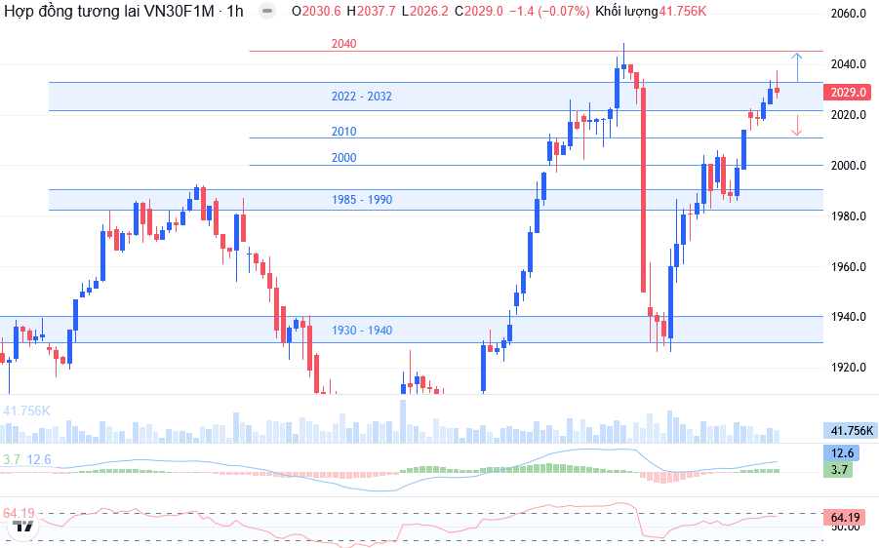
DERIVATIVES MARKET
Technical Analysis
VN30F1M closed at 2,029, up by 14.9 points (+0.7%). The liquidity dropped. Gaining trend took control in most trading time.
On 1-hour chart, the price closed with shooting star candle, showing the selling taking control at resistant of 2,030 – 2,035. RSI nearly approached overbuying, and there might be correction to recreate the trend. 15-minute chart also showed possibility of dropping. Testing level is expected at around 2,022 – 2,032. Long side is considered when breaking and supporting above 2,032. Short side is considered when dropping to below 2,022.
VN100F1M closed at 1,919.9, up by 19.8 points (+1.0%). Basis gap is 1.9 points (above basic VN100). Matched volume increased to 107 contracts. Close support is around 1,900 while resistant is 1,935 – 1,940.
Daily strategy
Position | Trading point | Take profit | Cut loss | Reward/risk ratio
Long | > 2.032 | 2.045 | 2.024 | 13 : 08
Short | < 2.022 | 2.012 | 2.030 | 10 : 08

Slide 11
VN30 INDEX FUTURES 1 MONTH CONTRACT
Open interest
Net trading contracts of foreign investors
Net trading contracts of institutions
Basis of future contracts
Yield curve of future contracts
VN30F1M – VN30F2M

Slide 12
EVENTS CALENDAR & DAILY NEWS
01/12 | Vietnam & US – PMI Index
05/12 | Vietnam– FTSE announces portfolio review US – Unemployment Rate
06/12 | Vietnam – Release of Economic Data for November and the First Eleven Months
09/12 | Australia – RBA Rate Statement
10/12 | Canada – BOC Rate Statement
11/12 | US - Federal Funds Rate, Producer Price Index (PPI)
12/12 | Vietnam – Vaneck announces portfolio review
17/12 | US – Retail Sales
18/12 | Vietnam – Derivatives Expiration US –Consumer Price Index (CPI) UK – Official Bank Rate (BoE)
19/12 | Vietnam – Vaneck & FTSE ETF rebalancing trades Japan –BOJ Policy Rate
23/12 | US - Prelim GDP q/q (Q3)
31/12 | US – FOMC Meeting Minutes
MACRO INFORMATION
HCMC budget collection is about 785 trillion in 2025: expectedly until the end of 2025, total state budget collection in HCMC is about 785 trillion, reaching 116.9% estimates assigned.
FED December meeting still divided: the voting was quite tight, showing America central bank internal disagreements. The disagreement took place with discussion of FOMC should support labor market or worry about inflation. This is the first clear disagreement since 2019.
China tightens on silver export, applying rare earth control strategy: According to CNBC, China expects to tighten on silver export control from January 1, 2026. China’s action will cause trouble for America, since this metal plays important role in industries and defense. Tesla CEO Elon Musk criticized China policy at the end of last week.
CORPORATION NEWS
CTD - Coteccons wants to take over a foundation company: Coteccons approved to buy 100% GEO Foundations Vietnam to expand to foundation, diversifying business, raising revenue and improving the brand. GEO Foundations chartered capital is 404.3 billion, President is Mr. Mikko Samuel Gastager. Besides, Coteccons issued nearly 5.1 million shares at the rate of 20:1, and pay 10% cash dividend on December 22, 2025. Coteccons total capital is expected to increase to over 1,078 billion after issuing.
VIC – VinFast moved into Congo: ambition for selling 100,000 motorbikes, same at peak level in Vietnam in only 1 quarter: Vingroup signed a project in 6,300ha city in Kinshaka and committed to supply 20,000 electric cars and 100,000 electric bikes in Q1/202, using favorable tax policy and limit importing second-hand cars. This 17-million population market with bike replacing demand. However, electric resource with approaching rate of 21% in Congo is big challenge for electric automobile operation.
HAH – Viconship raised owning rate to nearly 24% capital in Hai An Logistics: Viconship and subsidiary companies bought a total of over 18 million HAH shares, raising owning rate to nearly 24% capital in Hai An Logistics in December 2025. At the same time, Hai An Logistics expects to issue nearly 2.5 million ESOP shares at 10,000 dong/share to leaders and staffs, transfer limit is 3 years, expectedly in Q1/2026. The trade raises owning rate and issues shares to add in the company business capital.
NVL – Novaland received good news: Novaland started The Park Avenue project (two 32-story towers), expecting to finish in 2026, completing in Q3/2027, starting selling in April 2026. Many projects in HCMC center like Victoria Village, The Grand Manhattan are speeding up. In 2025 – 2026, Novaland delivered 10,500 certificates in many projects. Victoria Village project is completing, 3 big projects NovaWorld Phan Thiet, Ho Tram and Aqua City are legally completed, speeding up construction, operating new utilities. Ngan Hiep, Novaland subsidiary company, became big project in Seaprodex in “golden location” Dong Khoi.

Slide 13
LISTS OF ANALYZED STOCKS

Slide 14
DISCLAIMER
Analyst Certification
The report was prepared by Le Tran Khang, Senior Analyst – Phu Hung Securities Corporation. Each research analyst(s), strategist(s) or research associate(s) responsible for the preparation and content of all or any identified portion of this research report hereby certifies that, with respect to each issuer or security or any identified portion of the report with respect to each issuer or security that the research analyst, strategist or research associate covers in this research report, all of the views expressed by that research analyst, strategist or research associate in this research report accurately reflect their personal views about those issuer(s) or securities. Each research analyst(s), strategist(s) or research associate(s) also certify that no part of their compensation was, is, or will be, directly or indirectly, related to the specific recommendation(s) or view(s) expressed by that research analyst, strategist or research associate in this research report
Rating definition
BUY: The code has gaining potential of over 20% RAISE WEIGHT: The code has gaining potential of 10% - 20%
HOLD: The code has limited growing potential of less than 10% LOWER WEIGHT: The code might drop slightly by 0% - 10%
SELL: The code might drop by over 10% NON RATED: The code is not rated within PHS’s observation range or not yet listed
Efficiency is total profit of 12 months (including dividend)
Disclaimer
This research report has been prepared by Phu Hung Securities Corporation (PHS) for informational purposes only. The information contained herein has been obtained from sources believed to be reliable, but PHS does not guarantee its accuracy or completeness. Opinions, estimates, and projections in this report constitute the current judgment of the author as of the date of this report and are subject to change without notice. This report is not an offer to sell or a solicitation of an offer to buy any securities. It is not intended to provide personal investment advice and it does not take into account the specific investment objectives, financial situation, or needs of any particular person. PHS, its affiliates, and/or their respective officers, directors, or employees may have interests or positions in, and may effect transactions in, the securities or options referred to herein. PHS may also perform or seek to perform investment banking or other services for the companies mentioned in this report. Neither PHS nor any of its affiliates, nor any of PHS’s respective officers, directors, or employees, accepts any liability whatsoever for any direct or consequential loss arising from any use of this report or its contents
© Phu Hung Securities Corporation
21st Floor, Phu My Hung Tower, 8 Hoang Van Thai Street, Tan My Ward, HCMC
Phone: (+84-28) 5 413 5479 Fax: (+84-28) 5 413 5472
Customer Service: 1900 25 23 58 Call-center: (+84-28) 5 413 5488
E-mail: info@phs.vn / support@phs.vn Web: www.phs.vn
District 1 Branch Room 1003A, 10th Floor, No. 81-83-83B-85 Ham Nghi Street, Sai Gon Ward, Ho Chi Minh City Phone: (+84-28) 3 535 6060 Fax: (+84-28) 3 535 2912 | District 3 Branch 4th Floor, 458 Nguyen Thi Minh Khai, Ban Co Ward, Ho Chi Minh City Phone: (+84-28) 3 820 8068 Fax: (+84-28) 3 820 8206 | Tan Binh Branch Park Legend Building, 251 Hoang Van Thu Street, Tan Son Hoa Ward, Ho Chi Minh City Phone: (+84-28) 3 813 2401 Fax: (+84-28) 3 813 2415
Thanh Xuan Branch 5th Floor, UDIC Complex Building, N04 Hoang Dao Thuy, Thanh Xuan Ward, Ha Noi Phone: (+84-24) 6 250 9999 Fax: (+84-24) 6 250 6666 | Hai Phong Branch 2nd Floor, Building No.18 Tran Hung Dao, Hoang Van Thu Ward, Hong Bang Ward, Hai Phong Phone: (+84-22) 384 1810 Fax: (+84-22) 384 1801

