Slide 1
CORRECTING PRESSURE TOOK CONTROL, THE LIQUIDITY DROPPED AFTER “BOTTOM-CATCHING” SESSION
22/05/2026
REMARKABLE POINTS ON THE MARKET
Situation: VN-Index closed at 1,896.9, down by 16.3 points (-0.85%). The liquidity dropped and leaned on sellers. Red was recorded on VN30 while HNX-Index gained.
Remarkable points of the session: cautiousness took control again. The cash flow still differentiated and moved quickly among groups, not yet forming specific leading group.
Positive groups: Banking: VIB (+1.3%), LPB (+1.7%) l Basic resources: HSG (+2.1%), DHM (+3.0%) l Construction and materials: DPG (+3.5%), PC1 (+6.8%) l Tourism and entertainment: VJC (+1.7%), VPL (+2.1%). Negative: Real estate: NVL (-3.8%), VIC (-3.5%), DXG (-2.4%) l Industrial goods and services: GEE (-3.7%), GEX (-2.8%), PVT (-2.7%) l Power, water, and fuel: GAS (-2.7%), POW (-2.5%) l Oil: BSR (-3.5%), PLX (-2.1%).
Impact: gaining side | VPL, MWG, LPB, HPG, VCB – Dropping side | VIC, GAS, GVR, BSR, GEE
Foreign net selling was over 1.6 trillion, focusing on VIC, FPT, MBB, and net buying was on VPB, VCB, LPB.
TECHNICAL POINT OF VIEW
% Performance of the Indexes since 2025
VN-Index closed with red candle below day-MA10, showing short-term weakening sign and higher correcting pressure if the index doesn’t soon recover to above this level. The liquidity also dropped, showing more cautious demand. Meanwhile, technical indicators MACD and RSI dropped further, showing weaker boost. Accordingly, the index might continue testing the level of 1,850 – 1,880. On more cautious scenario, gaining trend is only supported when VN-Index surpasses and stays stable above 1,920.
For HNX-Index, it gained but the liquidity hasn’t agreed. If the demand doesn’t improve, risk of testing 260 will increase. Close technical resistant is around 270.
Strategy: tend on restructuring. Should utilize to lower weight on the codes that broke the trend and dropped out of important support level, and limit chasing when recovering sign is not reliable. The weight should stay at low average and continue observing the market.
STOCK RECOMMENDATION
Continue observing the market
Derivatives (page 09)

Slide 2
MARKET STATISTICS
Market performance YTD
Source: FiinPro, PHS compiled

Slide 3
MARKET STATISTICS
Market performance of regional and key global equity markets
Global commodity prices performance
Source: Bloomberg, PHS compiled
Note: S&P 500, Dow Jones, FTSE 100 and Euro Stoxx 50 index reflect the previous trading session
Source: Bloomberg, PHS compiled
Note: (*) Price indices for the Chinese marke

Slide 4
MARKET STATISTICS
TOP SECTORS IMPACTING VNINDEX
TOP TICKERS IMPACTING VNINDEX
TOP FOREIGN INVESTOR NET TRADE TICKERS VNINDEX
TOP SECTORS IMPACTING HNXINDEX
TOP TICKERS IMPACTING HNXINDEX
TOP FOREIGN INVESTOR NET TRADE TICKERS HNXINDEX

Slide 5
MARKET STATISTICS
TOP TRADING VALUE TICKERS (VND bn) - VNINDEX
TOP TICKERS IN AGREEMENT TRADE (VND bn) - VNINDEX
FOREIGN INVESTORS’ NET TRADING VALUE (VND bn) - VNINDEX
TOP TRADING VALUE TICKERS (VND bn) - HNXINDEX
TOP TICKERS IN AGREEMENT TRADE (VND bn) - HNXINDEX
FOREIGN INVESTORS’ NET TRADING VALUE (VND bn) - HNXINDEX

Slide 6
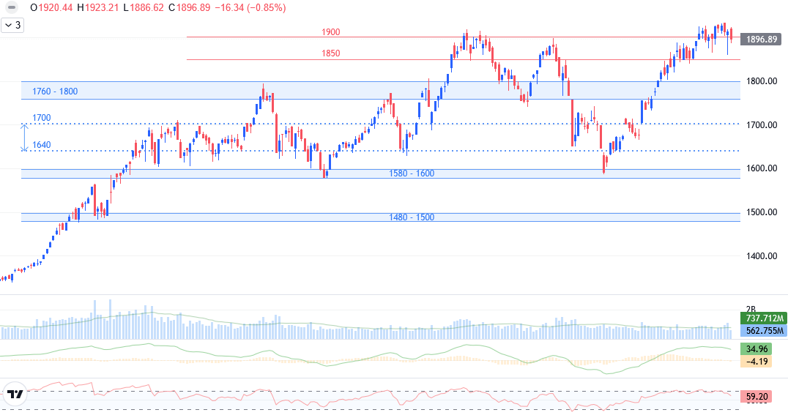
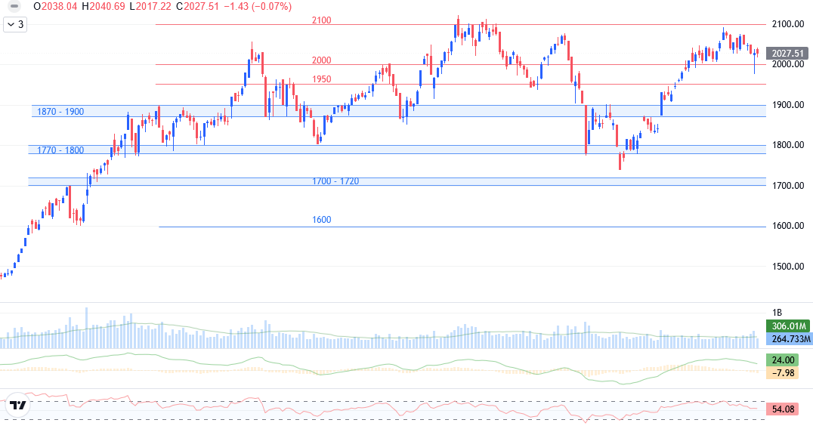
TECHNICAL ANALYSIS
VNINDEX TECHNICAL ANALYSIS
Red candle, the volume was below 20-session average.
Support: 1,800 l 1,850.
Resistant: 1,920 l 1,950.
MACD dropped, RSI dropped from overbuying level.
Trend: dropped and support the trend.
Scenario: red candle following previous Doji candle hasn’t confirmed gaining trend. The liquidity was also low, showing the cash flow being cautious again. Need gaining candle closing above 1,920 to confirm the trend. On the contrary, correcting pressure might take further control, with target of testing the level of 1,850.
VN30 TECHNICAL ANALYSIS
Red candle, the volume was below 20-session average.
Support: 1,970 l 2,000.
Resistant: 2,070 l 2,120.
MACD dropped, RSI dropped from overbuying level.
Trend: dropped and support the trend.
Scenario: the trade was still below resistant of 2,050 – 2,070, showing the selling still in control. Gaining trend is confirmed when VN30 breaks and supports above 2,070. On the contrary, correcting pressure will still be in control, with target of testing sentimental level of 2,000.

Slide 7
LIST OF RECOMMENDATIONS
Recommendations of the day
List of recommendations

Slide 8
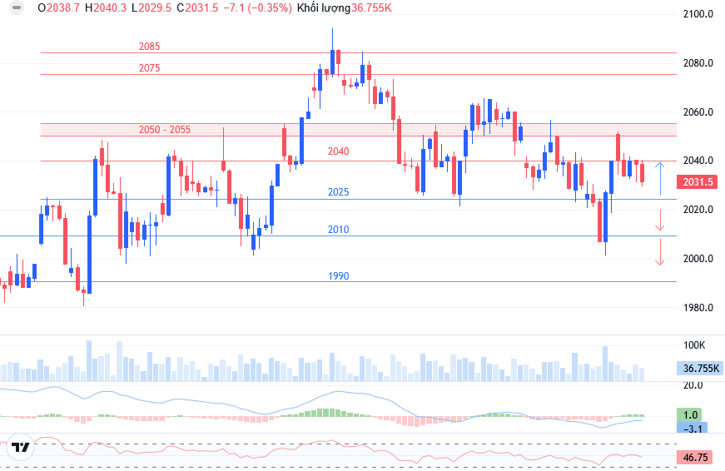
DERIVATIVES MARKET
Technical Analysis
VN30F1M closed at 2,031.5, down by 8.5 points (-0.4%). Correcting pressure took control in most trading time. May 21 is also maturing date.
On 1-hour chart, MACD improved but was still below negative level, and RSI only recovered to average, showing correcting pressure still took control. Since 1-month contract matured and nearly 20-point different from 2-month contract, the price will be balance again. Expected testing level is around 2,010 – 2,025. Long side is considered when supporting above 2,026. Short side can wait until the price weakens to below 2,020, or join if dropping to below 2,006.
VN100F1M closed at 1,955.3, down by 6.7 points (-0.3%). Basis gap was 3.3 points (above basic VN100). Matched volume increased to 51 contracts. Close support is around 1,940, while resistant is 1,970 points.
Daily strategy

Slide 9
VN30 INDEX FUTURES 1 MONTH CONTRACT
Open interest
Net trading contracts of foreign investors
Net trading contracts of institutions
Basis of future contracts
Yield curve of future contracts
VN30F1M – VN30F2M

Slide 10
EVENTS CALENDAR & DAILY NEWS
01/05 | Vietnam & US – PMI index
03/05 | Vietnam – Socio-economic report for April 2026
08/05 | US - Unemployment Rate, Non-Farm Employment Change
09/05 | US – FOMC Members’ Speeches
11/05 | China – CPI, PPI index
12/05 | US – CPI index
13/05 | US – PPI index Vietnam - MSCI Index Review Announcement
14/05 | US - Retail Sales
18/05 | China – Industrial Production, Retail Sales
21/05 | Vietnam – Derivatives Expiration US - FOMC Meeting Minutes
28/05 | US - Prelim GDP, Core PCE Price Index
31/05 | China – PMI index
MACRO INFORMATION
Import, export in first half May 2026 is about 48 billion USD, import surplus increased: In first half May, total import-export is nearly 48 billion USD, down slightly by 1.7% YoY, in which export is over 21 billion USD, import is 26.71 billion USD, up by 10.2%. Different from the light drop on export, import increased strongly further in first half of May, pulling the deficit in first half of the month to nearly 5.7 billion USD. In total, import surplus in 5.5 months of 2026 is about 14 billion USD.
America – Iran started “final phase”, Trump still threatened to attack again: America President Donald Trump stated to interviewers that the negotiation between Washington and Tehran is at “final phase”, so investors hope that two parties will soon reach agreement. Bond interest rate and oil price both dropped strongly. However, Trump also threatened to return to striking campaign in the next few days if Iran doesn’t approve America conditions.
CORPORATION NEWS
PHR – Phuoc Hoa Rubber will soon receive trillion dong of compensation: the project scale is about 785ha, in Tan Uyen ward, HCMC, developed by billionaire Tran Ba Duong’s THACO. According to the company, the compensation and damage sponsor because of early harvest on rubber plant garden to deliver the ground is expected at over 1.4 trillion. Besides, the company completed negotiating with Vietnam Singapore (VSIP) on adjusting the compensation in VSIP III, at total value of 3,260 billion.
IMP – Imexpharm President and two BoM member resigned after being merged by China company: according to the company, applying to resign from BoM are Mr. Woo Sungmin – President, non-managing BoM member; Mr. Truong Minh Hung – non-managing BoM member, and member of Audit Committee; and Mr. Chung Suyong – independent BoM member. Besides, these members no longer own any share in Imexpharm.
FPT pays remaining 10% cash dividend of 2025, issuing ESOP shares: FPT will pay 10% dividend, or 1,000 dong per share. Closing date is May 29, 2026. The company expects to spend over 1,703 billion on this cash dividend payment. On the same day, FPT BoM approved ESOP issuance in 2023 – 2025. Expected issuance is 8,517,301 shares, par value is 10,000 dong/share.
HAH – Vietnam Container (VSC) related group bought nearly 1.49 million shares in Hai An: Nam Hai Dinh Vu bought 1,488,540 shares to raise owning rate from 0% to 0.79% chartered capital the trade took place from May 6 to 14. After the trade, related shareholder group owned 42 million HAH shares, or 22.3% chartered capital in Hai An. In which, remarkable group is Container Vietnam (VSC) that owns 15.86% capital in Hai An.
VJC – Vietjet issues shares to pay 30% dividend: BoM of Vietjet Airlines approved to issue shares to pay 2025 dividend. Accordingly, Vietjet shareholders will receive 30% dividend in share. Expected to issue in near future after completing procedures as regulated by law.

Slide 11
LISTS OF ANALYZED STOCKS

Slide 12
DISCLAIMER
Analyst Certification
The report was prepared by Le Tran Khang, Senior Analyst – Phu Hung Securities Corporation. Each research analyst(s), strategist(s) or research associate(s) responsible for the preparation and content of all or any identified portion of this research report hereby certifies that, with respect to each issuer or security or any identified portion of the report with respect to each issuer or security that the research analyst, strategist or research associate covers in this research report, all of the views expressed by that research analyst, strategist or research associate in this research report accurately reflect their personal views about those issuer(s) or securities. Each research analyst(s), strategist(s) or research associate(s) also certify that no part of their compensation was, is, or will be, directly or indirectly, related to the specific recommendation(s) or view(s) expressed by that research analyst, strategist or research associate in this research report
Rating definition
BUY: The code has gaining potential of over 20% RAISE WEIGHT: The code has gaining potential of 10% - 20%
HOLD: The code has limited growing potential of less than 10% LOWER WEIGHT: The code might drop slightly by 0% - 10%
SELL: The code might drop by over 10% NON RATED: The code is not rated within PHS’s observation range or not yet listed
Efficiency is total profit of 12 months (including dividend)
Disclaimer
This research report has been prepared by Phu Hung Securities Corporation (PHS) for informational purposes only. The information contained herein has been obtained from sources believed to be reliable, but PHS does not guarantee its accuracy or completeness. Opinions, estimates, and projections in this report constitute the current judgment of the author as of the date of this report and are subject to change without notice. This report is not an offer to sell or a solicitation of an offer to buy any securities. It is not intended to provide personal investment advice and it does not take into account the specific investment objectives, financial situation, or needs of any particular person. PHS, its affiliates, and/or their respective officers, directors, or employees may have interests or positions in, and may effect transactions in, the securities or options referred to herein. PHS may also perform or seek to perform investment banking or other services for the companies mentioned in this report. Neither PHS nor any of its affiliates, nor any of PHS’s respective officers, directors, or employees, accepts any liability whatsoever for any direct or consequential loss arising from any use of this report or its contents
© Phu Hung Securities Corporation
21st Floor, Phu My Hung Tower, 8 Hoang Van Thai Street, Tan My Ward, HCMC
Phone: (+84-28) 5 413 5479 Fax: (+84-28) 5 413 5472
Customer Service: 1900 25 23 58 Call-center: (+84-28) 5 413 5488
E-mail: info@phs.vn / support@phs.vn Web: www.phs.vn
District 1 Branch Room 1003A, 10th Floor, No. 81-83-83B-85 Ham Nghi Street, Sai Gon Ward, Ho Chi Minh City Phone: (+84-28) 3 535 6060 Fax: (+84-28) 3 535 2912 | District 3 Branch 4th Floor, 458 Nguyen Thi Minh Khai, Ban Co Ward, Ho Chi Minh City Phone: (+84-28) 3 820 8068 Fax: (+84-28) 3 820 8206 | Tan Binh Branch Park Legend Building, 251 Hoang Van Thu Street, Tan Son Hoa Ward, Ho Chi Minh City Phone: (+84-28) 3 813 2401 Fax: (+84-28) 3 813 2415
Thanh Xuan Branch Floor 5 - Office C, Taisei Square Hanoi Building - 289 Khuat Duy Tien Street, Dai Mo Ward, Hanoi City. Phone: (+84-24) 6 250 9999 Fax: (+84-24) 6 250 6666 | Hai Phong Branch 2nd Floor, Building No.18 Tran Hung Dao, Hoang Van Thu Ward, Hong Bang Ward, Hai Phong Phone: (+84-22) 384 1810 Fax: (+84-22) 384 1801

